Slide 1
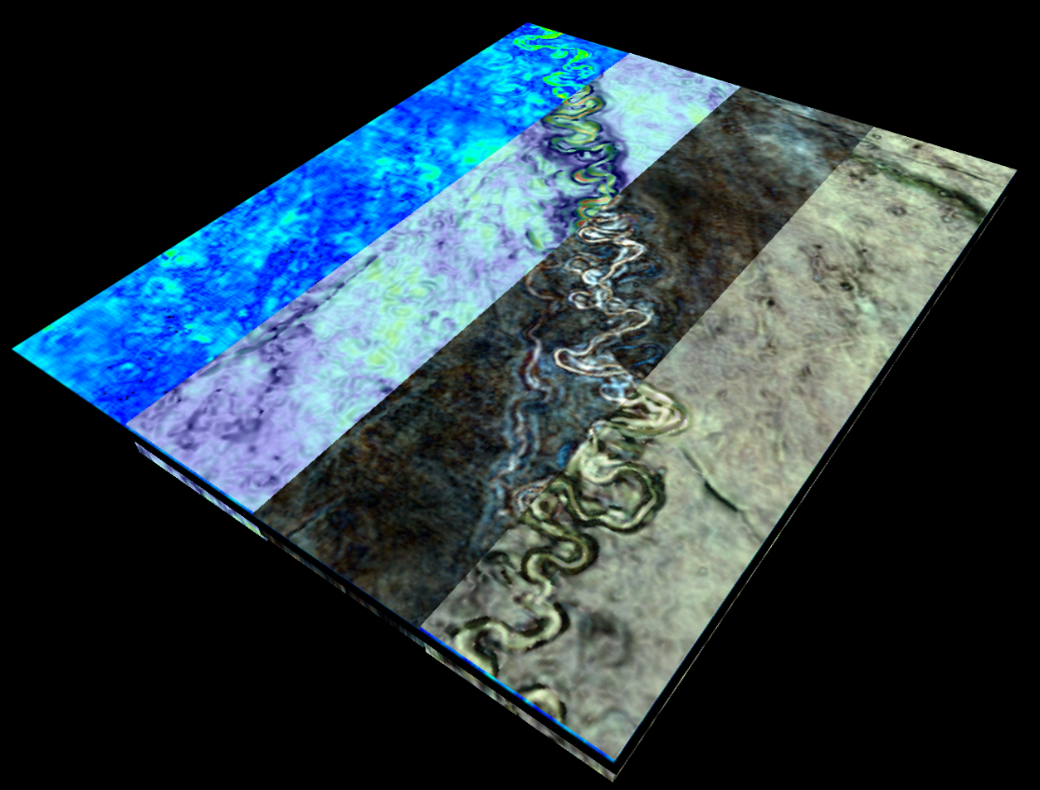
Seismic reflection data Lecture 6
Dr Rebecca (Becky) Bell and Raul Adriaensen
2nd floor, office 2.37a
rebecca.bell@imperial.ac.uk

Slide 2
Module outline
Day 2 morning- Visualising and interpreting seismic data
Lecture 4: The SEGY data convention and where to find data
Lecture 5: How to interpret seismic data
Lecture 6: Seismic attribute analysis and machine learning (future outlook)
Day 2 afternoon- Exercises
Exercise 3: Reading SEGY data and visualizing 3D data
Exercise 4: Calculating seismic attributes
Quick introduction to the assessment on 3rd Dec

Slide 3
Lecture outline
Objective of lecture 6:
Post-stack seismic attributes and the future of seismic interpretation
1) Grid-based post-stack seismic attributes
2) Volume-based post-stack seismic attributes
3) Potential for automation

Slide 4
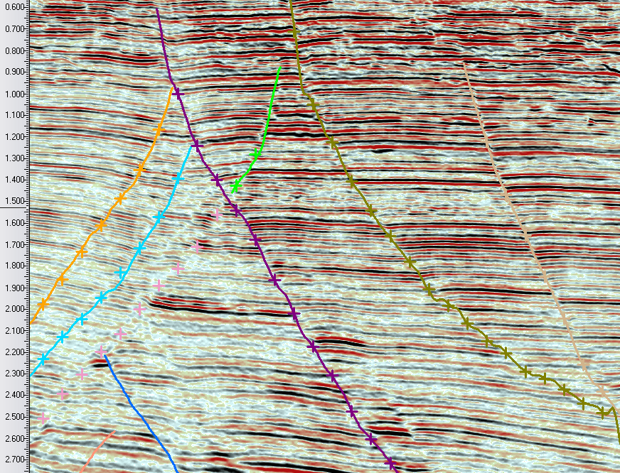
Conventional vs ‘cognitive’ interpretation
Conventional interpretation
Cognitive interpretation
Mapping to reveal geological features
Computing seismic attributes to reveal geological
features before mapping

Slide 5
Definitions
What is an attribute?
- “...A quality ascribed to any person or thing” (Oxford Dictionary)
What is a seismic attribute?
“...a quantitative derivative of a basic seismic measurement that may be extracted along a seismic trace, extracted along a horizon, or summed over a time window” (see Brown 2003; Hart & Chen, 2004)
In this lecture we focus on attributes derived from stacked data
What types of seismic attributes are available?
Grid-based attribute analysis
Volume-based attribute analysis

Slide 6
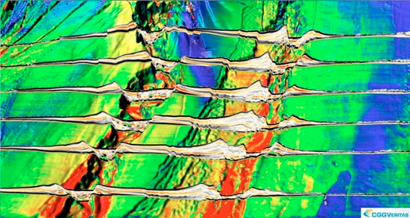
Grid-based seismic attributes

Slide 7
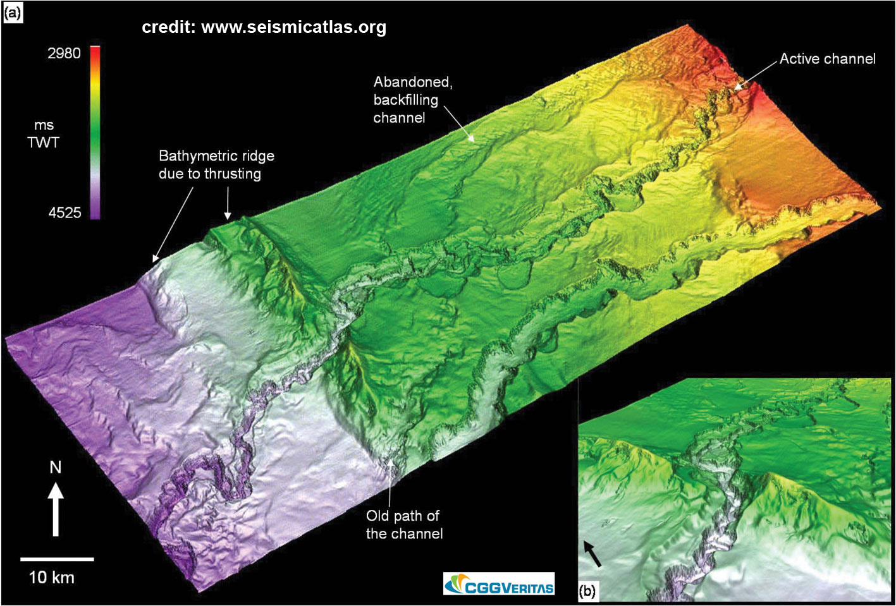
Time-structure maps
TWTT to a particular interpreted horizon
we can illuminate (hill shade) these diagrams to highlight features
Grid-based seismic attributes can be used to examine the morphology these surfaces in more detail
Geomorphologists use the same techniques with mapped surfaces on land (Digital Elevation models-
DEMs – you will have worked with these with Alex Lipp on Monday)

Slide 8
Grid-based seismic attributes
Grid-based attributes refer to attributes generated directly from a mapped seismic horizon
Grid-based attributes are calculated using an interpreted seismic horizon, thus the quality and interpretability of the resultant maps are directly linked to the quality of the initial interpretation; this may be limited by the quality of the original seismic dataset
They are a key part of the seismic interpreter’s toolkit and are applicable in a wide variety of structural and stratigraphic settings and across a range of scales
Three grid-based geometric attributes are typically available to the seismic interpreter; (i) dip; (ii) azimuth; and (iii) curvature

Slide 9
Dip and azimuth attributes
redrawn from Mondt (1993)
Dip - calculates the dip at each point on an horizon. The resultant map (termed a ‘dip map’) displays variations in the magnitude of dip. The map contains no information on dip direction or magnitude of offset across a structure (e.g. total displacement or displacement direction in the case of a fault). Typically used to delineate structural features (i.e. faults and folds)
Azimuth - calculates the azimuth at each point in degrees (˚) away from north and displays variations in the direction of dip. The map contains no information regarding the dip magnitude of a structure (e.g. total amount of displacement on a fault). Typically used to delineate large-scale structural trends within sedimentary basins.

Slide 10
Dip and azimuth attributes
A - Seismic section from the North Sea Basin illustrating the presence of low-displacement normal faults in the Tertiary succession. Note the mapped reflection event marked X
B - Dip map of reflection event X illustrates the polygonal pattern of the fault array
C - Azimuth map of reflection event X illustrating the polygonal pattern of the fault array in addition to the variable dip direction of individual faults

Slide 11
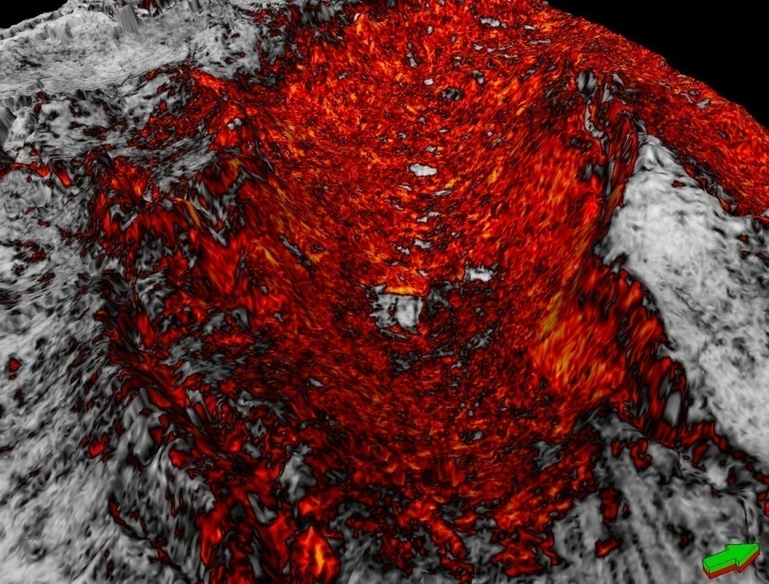
Volume-based attribute analysis

Slide 12
Volume-based seismic attributes
Volume-based attributes are derived directly from the seismic reflectivity volume
Volume-based attributes can be affected by noise in the initial input volume; caution should be exercised when interpreting geological features...
A key part of the seismic interpreter’s toolkit, they are applicable in a wide variety of structural and stratigraphic settings and across a range of scales
Two types of volume-based attributes are defined; (i) geometric; and (ii) amplitude
Hundreds of volume-based seismic attributes exist… you may be able to design your own (basically, any calculation you do on the seismic data reveals a seismic attribute, which may or may not be useful for resolving environmental/geological features)

Slide 13
Coherency/discontinuity/semblance
Coherency, discontinuity, variance and semblance-type volumes is one of the most commonly-used volume-based geometric attributes used by seismic interpreters
(a) illustrates a simple geological cross-section characterised by a normal-faulted sand (stippled)-shale (grey) sequence; (b) is a schematic sketch of how the coherence attribute ‘sees’ these lithological variations and the fault
Note the discontinuity ‘spike’ (or decrease in coherence) at the location of the normal fault due to an abrupt change in the spatial seismic character of reflection events

Slide 14
Coherency/discontinuity/semblance
+
-
Combination of vertical and timeslice displays from a standard reflectivity volume and a coherence cube illustrating the application of coherency to imaging normal faults
Note the clear expression of the normal faults on the vertical reflectivity slice and the coherency timeslice. The left-hand fault is more poorly-imaged on the reflectivity timeslice and the vertical coherency slice. Better imaging on timeslices rather than vertical slices is typical for coherency-type volumes

Slide 15
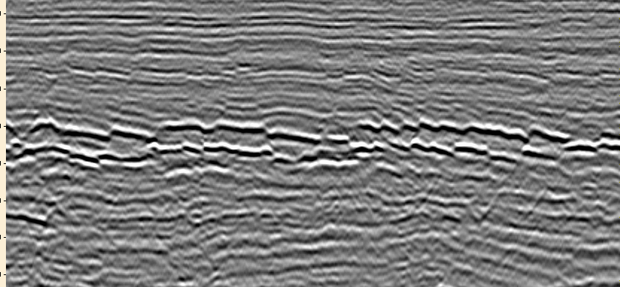
Coherency/discontinuity/semblance
SW
NE
1 km
Image courtesy of Lidia Lonergan
Seismic section from the Oligocene-Miocene succession of the northern North Sea
Note the development of a series of low-displacement normal faults
A timeslice (yellow line) is extracted from both the reflectivity volume and corresponding coherency volume (see next slide)

Slide 16
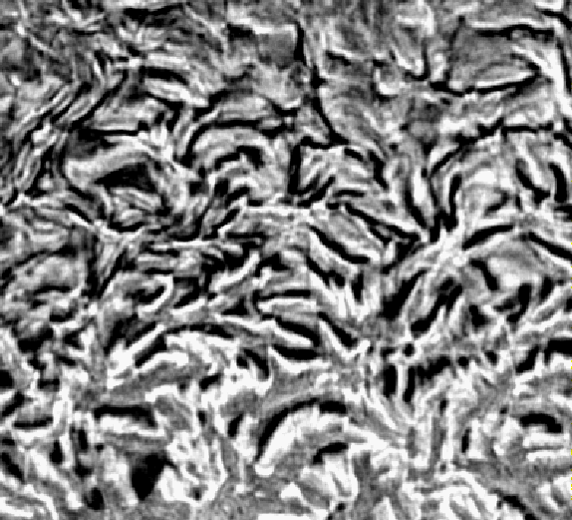
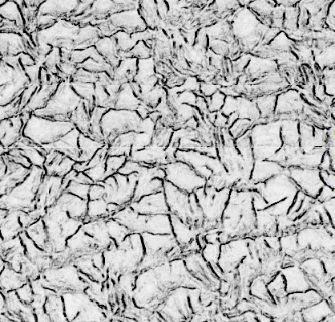
Coherency/discontinuity/semblance
1.25 k
m
1.25 k
m
Images courtesy of Lidia Lonergan
Above-left – Timeslice through reflectivity volume. Faults are poorly-imaged due to structural ‘interference’ with shallowly-dipping reflection events (see previous slide)
Above-right – Timeslice at the same structural level through a coherency volume. The faults are very clearly-imaged

Slide 17
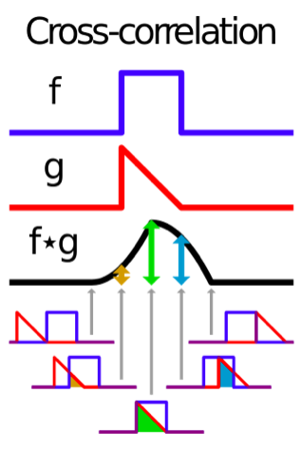
Discontinuity algorithms
Take a look at the following tutorial on Github from Joe Kington. There is a nice introduction to the use of discontinuity attributes and calculating them yourself
We are focusing here on attributes that compare the local similarity/variance of traces. In image processing these would be considered like a type of “3D edge filter”
The attributes are referred to as ‘semblance’, ’coherence’, ‘similarity’, ‘discontinuity’, ‘chaos’ and many other terms. We are using the term “discontinuity” for this whole family of terms
Most discontinuity attribute algorithms are trade-secrets within seismic interpretation packages- and the vast majority of interpreters just use them as a ”black-box”
The earliest discontinuity algorithm uses the maximum cross correlation value of traces. The entirety of each trace is correlated within a moving-window subset of two neighboring traces.
You will explore discontinuity attributes in Ex 4
http://www.ceri.memphis.edu/people/egdaub/datanotes/_build/html/sac5.html

Slide 18
Amplitude-based attributes derived from grids and volumes
Amplitude algorithm extraction methods aim to delineate map-view distributions
of amplitude anomalies (ie areas where the wiggles of the seismic trace have abnormally
high or low amplitude)
There are an almost indefinable number of amplitude extraction algorithms....
(energy half-time, maximum positive or negative amplitude, reflection intensity,
total energy, average amplitude etc etc...)
We can extract amplitude along or in a window around a mapped horizon or
along a time/depth slice or within a time/depth volume
We will focus on only the most commonly used types of amplitude extraction

Slide 19
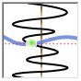
Amplitude extraction algorithms
Some examples of amplitude extraction algorithms...
Extract amplitude value (this is what a time slice does)
Maximum amplitude within a time window
Minimum amplitude within a time window
RMS amplitude (square root of the sum of squared amplitudes divided by number
of samples within specified window. Both high amplitude peaks and troughs
contribute to the value)
Can be done in a time window or between horizons

Slide 20
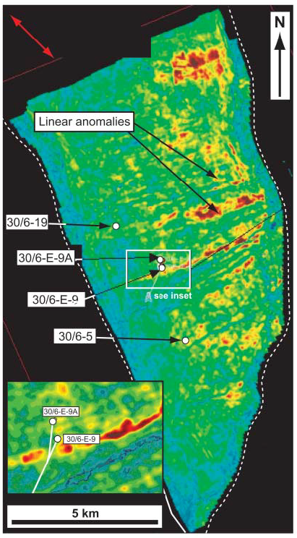
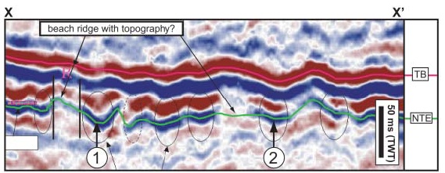
RMS amplitude
Scans a user defined piece of data and squares the amplitude at each sample
point. Both relatively strong negative and positive anomalies are boosted with
respect to low-amplitude “background” reflections.
(left) RMS amplitude extraction from a 16 ms window
centred on the near Top Etive formation (NTE-bottom),
North Sea
RMS amplitude map reveals linear ENE-WSW LOW
amplitude (red) anomalies which are interpreted as
beach ridges
Jackson et al. 2010

Slide 21
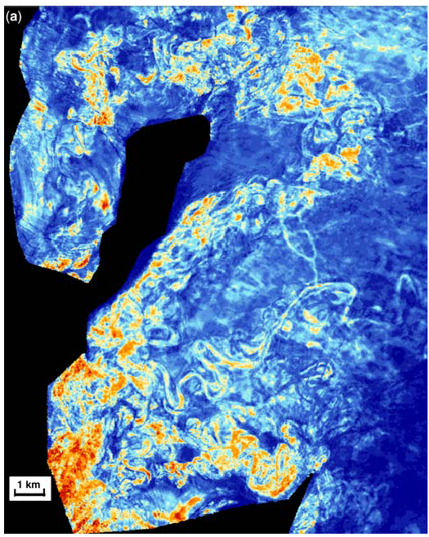
RMS amplitude
Channel system, Angola, Ekstrand et al. 2010

Slide 22
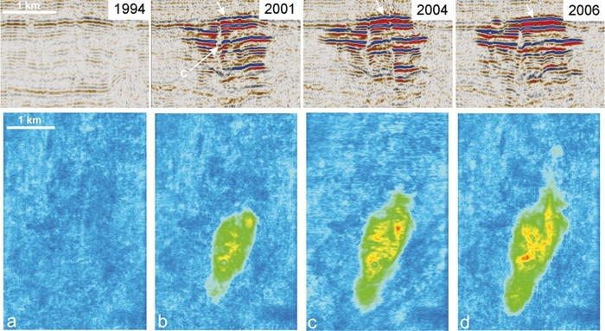
4D seismic and RMS
250 m
Sleipner CO₂
storage site,
North Sea
Red = higher
amplitude
Blue =lower
amplitude
http://www.bgs.ac.uk/science/CO2/home.html
3D seismic data acquired at different times over the same area (time-lapse)
Require exactly the same source, receiver and survey configuration
Used to asses monitor CO2 storage
http://www.bgs.ac.uk/science/CO2/home.html

Slide 23
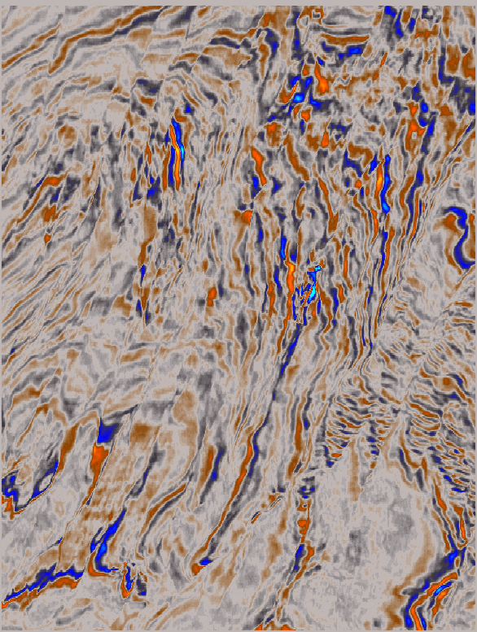
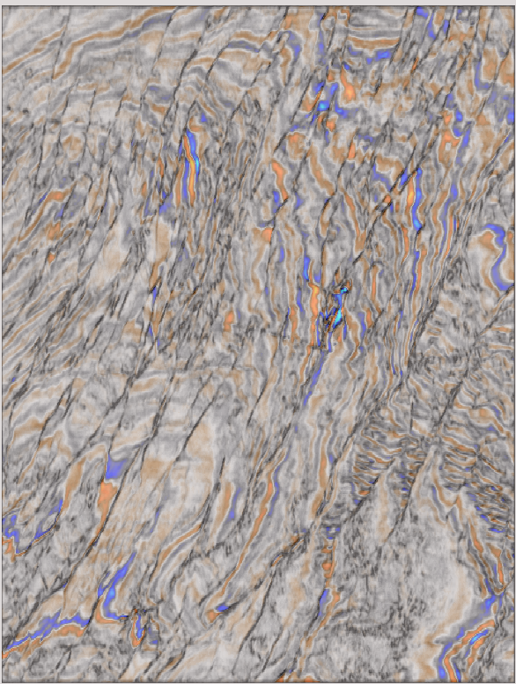
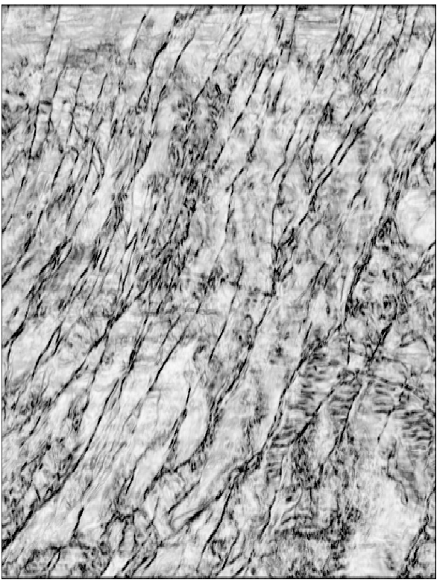
Multi-attribute analysis- superposition
Reveals the relationship between two images.

Slide 24
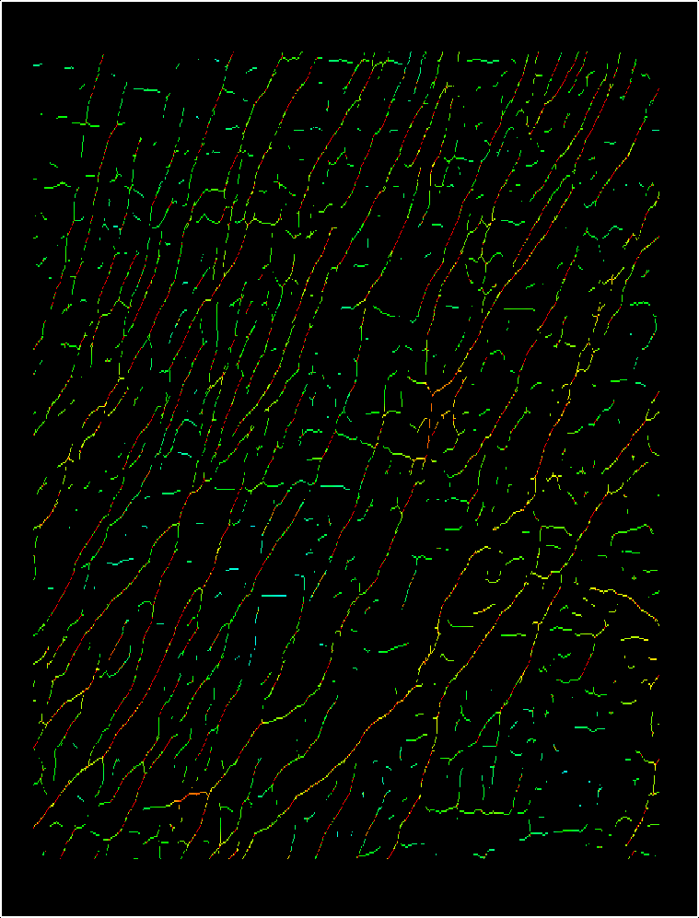
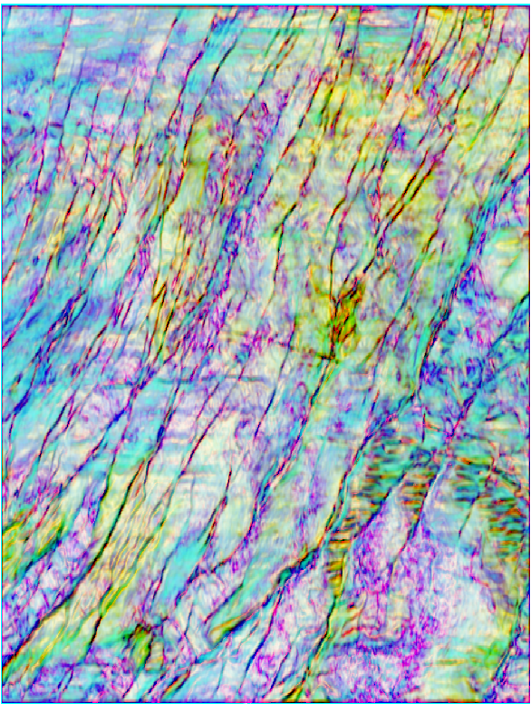
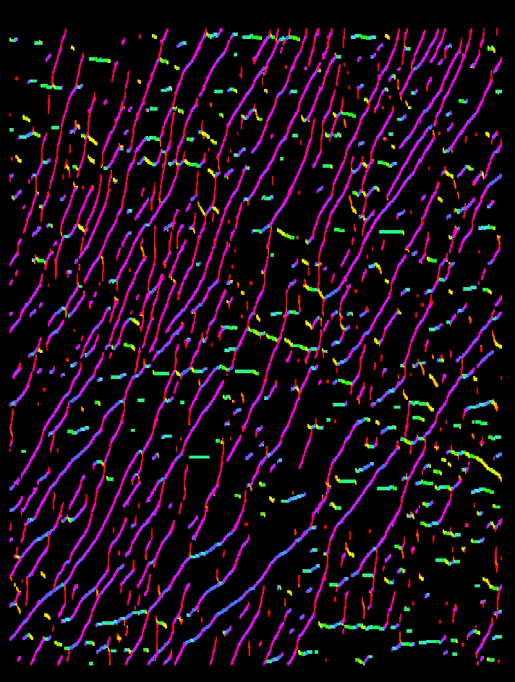

Explicit Encoding: increasing the amount of information
Fault confidence
Fault trends
Dip
SOS
Tensor

Slide 25
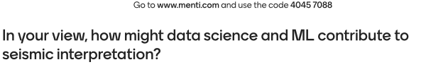
A question for you…

Slide 26
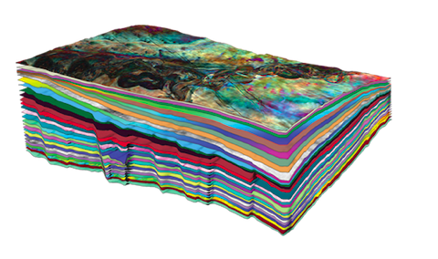
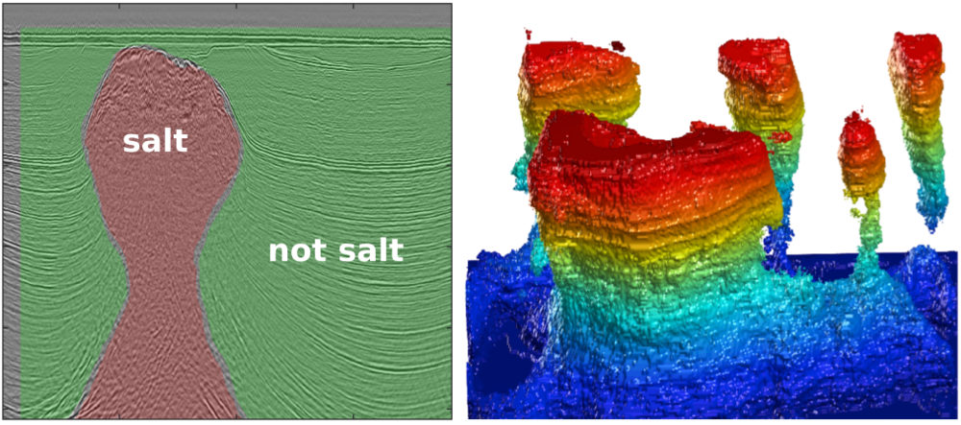
Automation and ML
3D seismic volumes have increased significantly in size over the last few decades. The volume of data that now exists is difficult/impossible for teams of humans to interpret fully
With the vast array of seismic attributes available it is difficult/impossible for a human interpreter to fully appreciate patterns and connections between them, meaning geological information is likely missed
Automation (doing repetitive, routine tasks in an automated way) and machine learning (understanding patterns and relating them to geological information) could revolutionize the field of seismic interpretation, allowing larger volumes of data to be interpreted in useful time frames, allow deeper geological understanding (particularly when seismic data and drilling data are used together)
https://agilescientific.com/blog/2017/6/20/machine-learning-meets-seismic-interpretation
https://www.eliis-geo.com/paleoscan-workflows-a.html

Slide 27
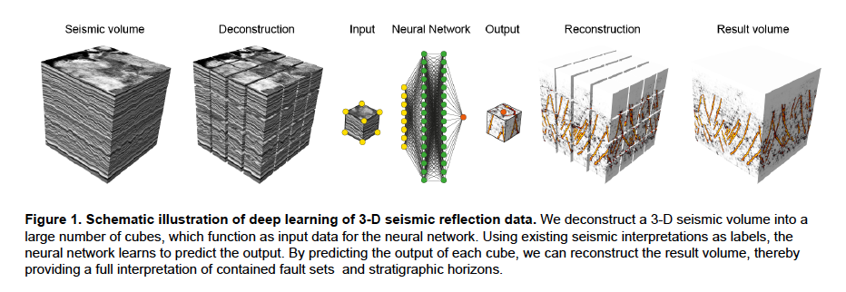
Machine learning in seismic interpretation
Wrona et al. 2021 (Leading edge): Deep learning for fault extraction
Notes:
Machine learning describes a set of algorithms and models, which learn to perform a specific task
without explicit instructions. While classic machine learning relies on features engineered for a specific
task (e.g. edges for fault detection), deep learning models derive features implicitly as part of the training.
To learn these features, deep neural networks typically require a large number of examples, either labelled
for supervised learning or unlabelled for unsupervised learning (e.g. LeCun et al., 2015). To generate
these examples, we interpret different geological structures (faults, salt bodies and a horizon) in a subset
of our data and subsequently divide this subset into a large number of patches, i.e. squares in 2-D and
cubes in 3-D (Fig. 1). Next, we split all of these examples into one set for training and one for validation
and one for testing. The training set is used to train the model to predict the labels. The validation set is
used for an evaluation of the trained model, which allows us to fine-tune hyperparameters during training.
The test set is used for an unbiased evaluation of the fine-tuned model.

Slide 28
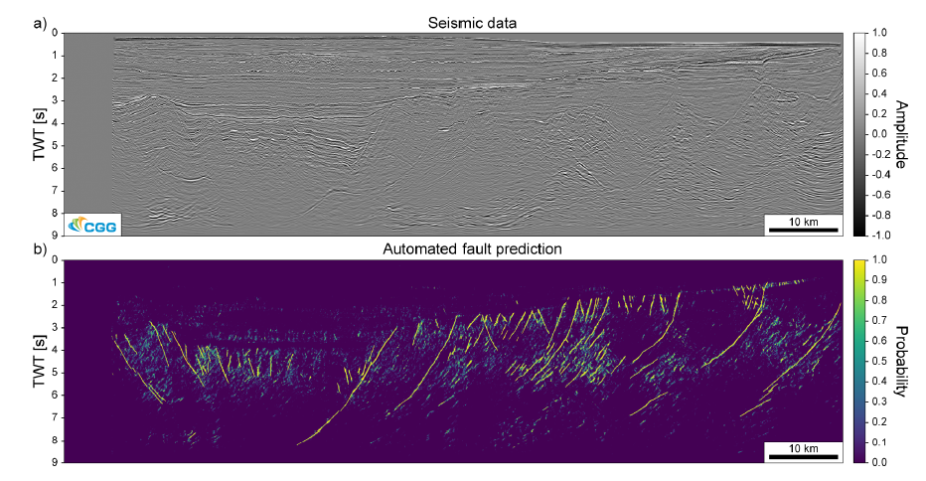
Machine learning- the future of interpretation?
In this example 10 seismic profiles through the 3D cube have been
Interpreted as “training data”
A python scripts treats the cube in small blocks and searches for things that look like the training data. These features are picked in terms of the probability that they are faults
Example from Dr. Thilo Wrona (University of Bergen), using data from CGG

Slide 29
Automation and ML
Below are some thoughts and idea of science topics that could be addressed with Machine Learning and seismic and in some cases drilling data (biased by my own interests!):
How does the Earth’s crust break-up to form new oceans? Would require all resolvable faults to be extracted from seismic volumes spanning whole rifts (due to oil and gas exploration these datasets exist in places like the North Sea, NW Australia)
Is there a relationship between subducted sediments and seismic hazard at subduction zones? There is a theory that the thickness and physical properties of sediments could control whether a subduction zone is capable of rupturing in very large (> magnitude 9 earthquakes). ML could help investigate if any global relationships exist using a combination of seismic and well data.
Which faults have greatest geothermal energy potential? At the moment we don’t know from seismic data which faults are conduits for (geothermal) fluid and which are seals (which is important for CO2 storage). ML with a combination of seismic and drilling data may reveal differences in seismic attributes between faults that are conduits or seals.
Mapping shallow sediment properties in regions of wind turbine installation. ML could develop relationships between rock properties from wells and seismic properties to map sediment properties in 3D away from drill sites allowing better site characterization.

Slide 30
Learning outcomes
Understand the importance of post-stack seismic attributes (both grid-based and volume-based)
After Ex 4 appreciate how some basic post-stack attributes can be calculated using real data
Appreciate the potential role of data science and machine learning in revolutionizing the field of seismic data interpretation

Slide 31
Introduction to Exercise 3, 4 and assessment
In Exercise 3 and 4 you will load three different SEGY volumes, visualize them and have a look at the geological features and compute some simple post-stack attributes to reveal geological features even further
In the assessment you can expect to load a fourth SEGY file and conduct similar analysis, so make sure you are happy with all steps of Ex 3 and 4 (the extension
parts of the exercise will NOT be assessed)
In the assessment you will also be asked some questions to test your understanding of seismic reflection principles (e.g. ‘Describe the important elements of a seismic survey’, ‘Discuss the importance of post-stack seismic attributes’)

Slide 32
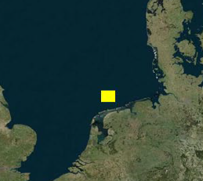

Data volume 1
TNW 3D Ultra-high resolution seismic (UHRS) (TNW_small2.segy)
Sparker source depth migrated dataset collected to develop a ground model for an offshore wind development at Ten noorden van de Waddeneilanden, north coast Netherlands
Netherlands Enterprise Agency (RVO) have released the data and geophysical reports
SAND Geophysics now developing a ground model from the data
We will look at just a subset of the data containing modern channels and evidence of past glaciations
TNW 3D UHRS geophysical report

Slide 33
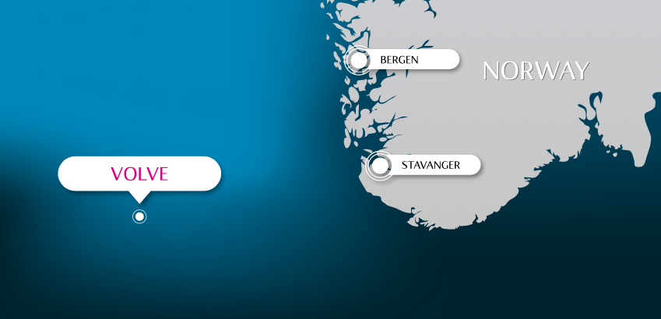
Data volume 2
Volve dataset (ST0202.segy)
Airgun array source time migrated dataset 200 km west of Stavanger, Norway
Equinor have released the full-dataset (40,000 files) for the 2016 decommissioned Volve oil field. Dataset includes seismic, wells, interpreted horizons and faults etc and is a great dataset for data scientists to explore
Old oil fields like this are now being re-considered as sites of CO₂ storage- see for example the CO2 storage atlas from the Barents Sea
This dataset is not a perfect rectangle… therefore when you load it you need to add some padding to make it a complete
rectangle. It is useful to know how to do this when you download your own data sets but IT WON’T BE ASSESSED on Friday

Slide 34
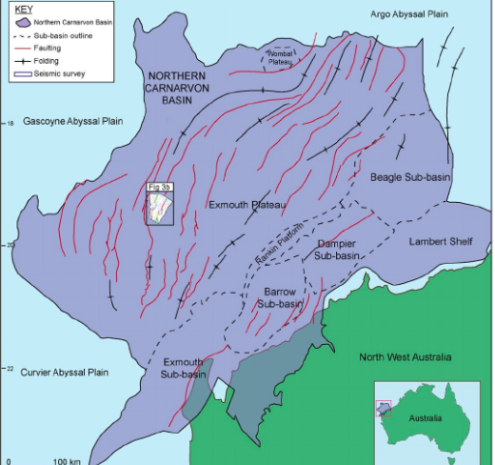
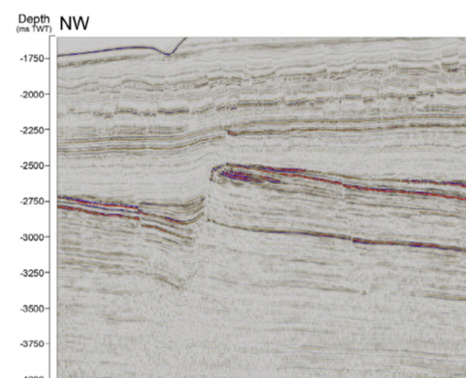
Data volume 3 (extension- if you have time)
Thebe 3D seismic (Thebe_rift_faults.segy)
Airgun array source time migrated dataset
Gas field located in Exmouth Plateau of NW Shelf Australia. Data open source from Geoscience Australia
Spectacular crustal-scale imaging of fault systems makes this an important datset for research into faults and earthquakes hazards eg. Pan, Bell et al. 2021
The dataset shows older Jurassic rifts and younger ’polygonal’ faults. We are going to look at the Jurassic faults

